Slide 1
Python Environment Setup and Installation

Slide 2
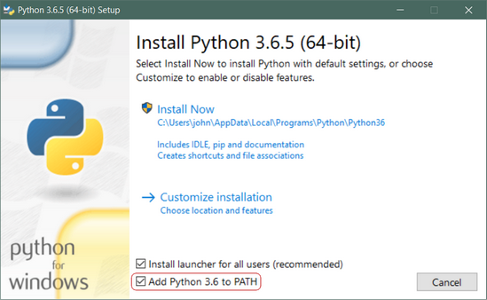
Windows
Step 1: Download the Python 3 Installer
Open a browser window and navigate to the Download page for Windows at python.org.
Step 2: Run the Installer
Make sure to add Path

Slide 3
Linux - Ubuntu
There is a very good chance your Linux distribution has Python installed already
But it probably won’t be the latest version, and it may be Python 2 instead of Python 3.
To find out what version(s) you have, open a terminal window and try the following commands:
python --version
python2 --version
python3 –version
Install Python on Ubuntu 16 and above
sudo apt-get update
sudo apt-get install python3.6

Slide 4
PIP
Pip enables 3rd party package installations.
Installing Pip
Download get-pip.py to a folder on your computer.
https://bootstrap.pypa.io/get-pip.py
Open a command prompt and navigate to the folder containing get-pip.py.
Run the following command:
python get-pip.py
Pip is now installed!
Verify: pip –V
Upgrading PIP for Python on Windows
python -m pip install --upgrade pip
Downgrade PIP Version
python -m pip install pip==18.1

Slide 5
PIP on Ubuntu
sudo apt update
sudo apt install python3-pip
pip3 –version
Using Pip
pip install <package_name>
pip uninstall <installed_package_name>
pip3 install scrapy==1.5
pip3 install -r requirements.txt
pip3 list
pip3 install --upgrade package_name

Slide 6
Installing and Launching Jupyter
python –m pip install –upgrade pip
# Optionally install Virtual Environment
pip install Jupyter
jupyter notebook
jupyter notebook --ip 0.0.0.0 --port 8888

Slide 7
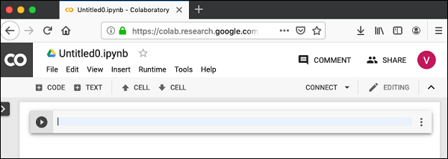
Google Colab
Login to Google Drive
Visit - https://colab.research.google.com/notebooks/welcome.ipynb
Click on the NEW PYTHON 3 NOTEBOOK link at the bottom of the screen.
A new notebook would open up as shown in the screen below.

Slide 8
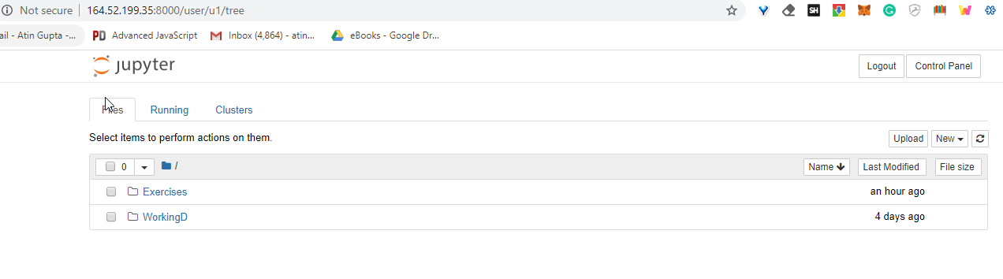
Our Development Environment on Cloud
We have setup the development environment on the cloud.
Refer to below details to access:
http://vmubuntu20.eastus2.cloudapp.azure.com/
Username: u<n>
Example:
u1
u2
u3
.
.
u22
Password:
Azure@123456

Slide 9
Thanks

